Slide 1
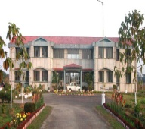
An overview on Trade and Distribution of Agar wood in North-East India
Dr. Rajib Kumar Borah
Scientist - F
Rain Forest Research Institute, Jorhat, Assam
(Indian Council of Forestry Research and Education)

Slide 2
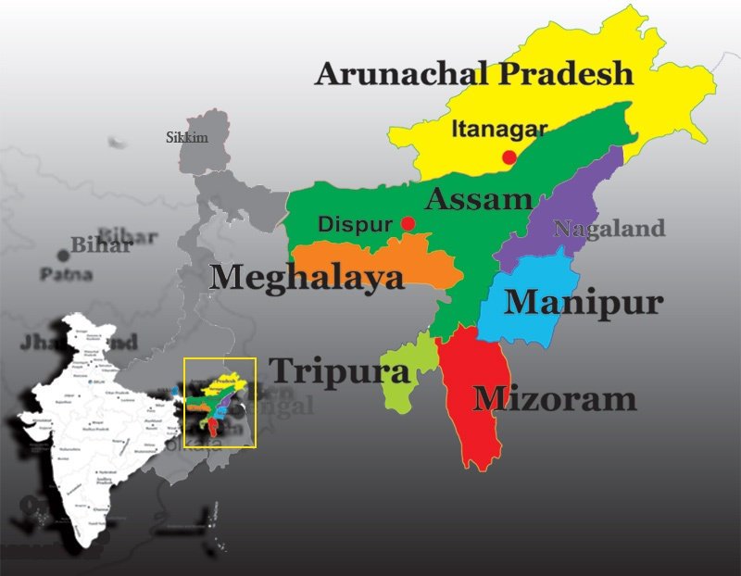

Slide 3
Introduction
Aquilaria malaccensis, also known as Agallochum (trade name), belongs to the Thymelaeaceae family. It occurs in North-eastern India through Myanmar to Peninsular Malaysia, Sumatra, Bangkok, Borneo and the Philippines.
The people of North-East India in general and Assam in particular had the knowledge of agarwood , locally known as “Agaru” or “Sanchi” since ancient times.
Pleasant aroma and costly medicinal values have been the cause of attraction of people since time immemorial.
Religious books or ‘puthis’ written on the specially treated bark glorified its position in the society and people started its plantation in the rear yards of their homes and within the campus of Thans and Satras.
In far East Asian countries, charring of agar-candle is an indispensable part of worshiping a deity.
Kings, Nawabs and the people in the higher echelon in the society bought and used the fungal infected chips and oil of agar as perfumery items and trading thereof has developed into a lucrative business from those days.
After the independence, people of various parts of Assam broached up this business and Hojai a tiny and cosy town of Nagaon district grew into a nerve center of this trade and commerce including Naharani and Namti in Upper Assam.
Rain Forest Research Institute, Jorhat, Assam
(Indian Council of Forestry Research and Education)

Slide 4
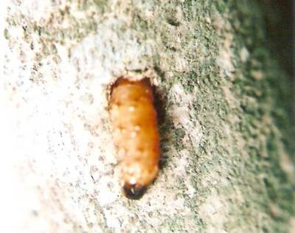
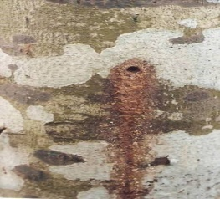
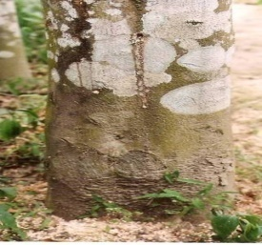
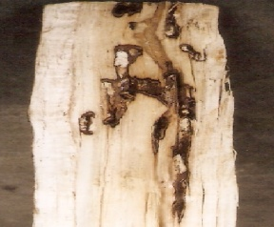
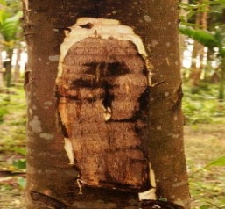
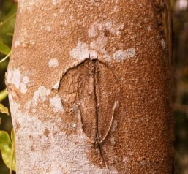
Agarwood Formation
Agarwood formation is the resinification of accumulated oleoresins due to the action of microorganisms.
The infection of fungus occurs when stem is injured or bored by larvae of a stem borer (Zeuzera conferta Walker).
The borer makes tunnels inside the tree trunks. Fungus enters the plant through this vertical hollow sometimes-zigzag tunnel inside the stem, which serves as the initial sites of infection.
The fungal infection takes long time to mature and trees about 50 years old have the highest concentration (2.5-5.0 kg/tree).
Rain Forest Research Institute, Jorhat, Assam
(Indian Council of Forestry Research and Education)

Slide 5
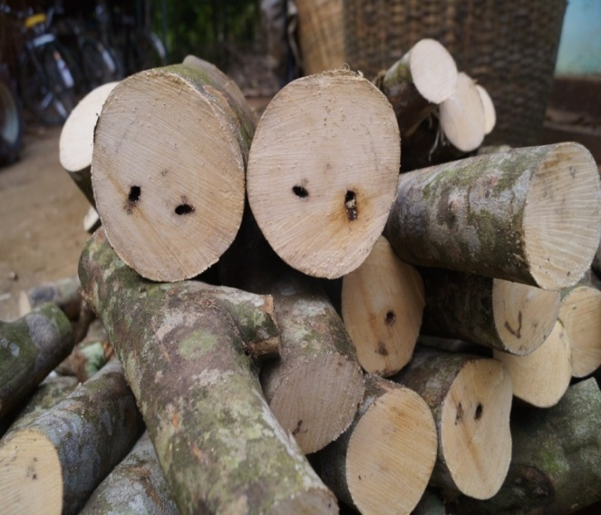
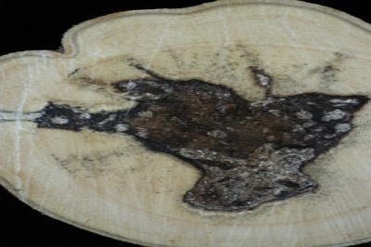
Agarwood Formation
Logs of Agar tree
Formation of agar-wood along the borer’s tunnel
Agarwood formation in the heart wood
Rain Forest Research Institute, Jorhat, Assam
(Indian Council of Forestry Research and Education)

Slide 6
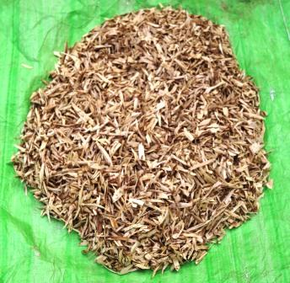
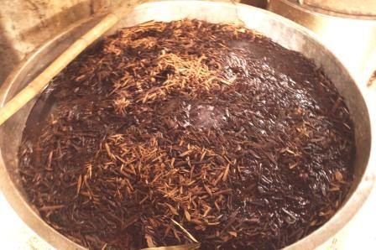
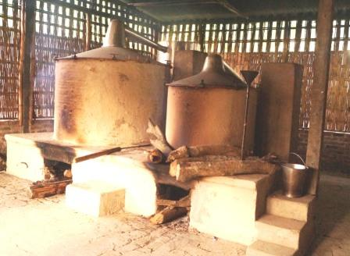
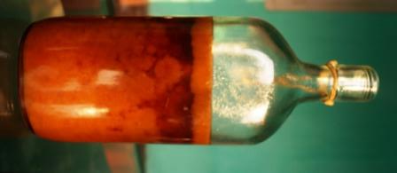
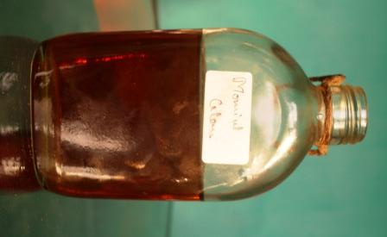
Agarwood chips
Fermented Agarwood chips
Different grades of Agar oil
Distillation Unit
Rain Forest Research Institute, Jorhat, Assam
(Indian Council of Forestry Research and Education)

Slide 7
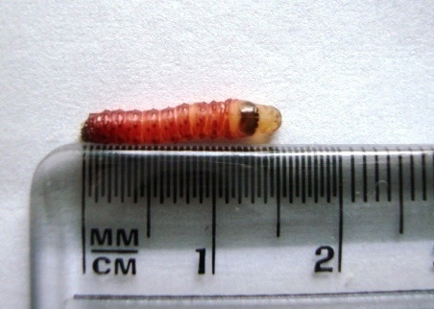
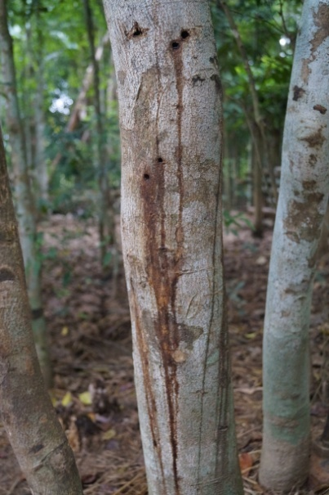
Natural Resin formation
Zeuzera conferta Walker
Oozing out of watery substances from fresh borer hole
Frass at the base of the tree

Slide 8
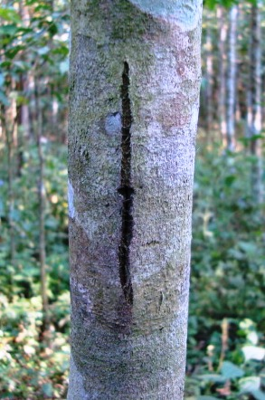
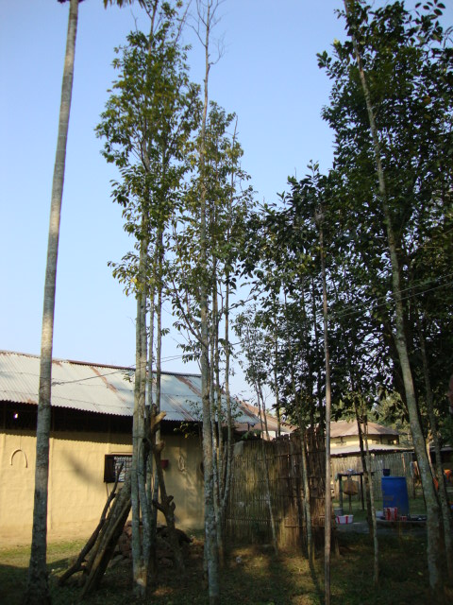
Keys for Identification of the Infected Agar Trees
Natural closing of borer’s hole
Cracking symptom
Sickly appearance of agar tree is a sign of agarwood formation

Slide 9
External symptoms for identification of agarwood formation in homestead/natural plantation
Appearance of borer hole.
Oozing out of watery substances from fresh borer hole.
Accumulation of frass at the base of the tree.
Closing of borer hole by the growth of host tissue leaving a small spindle shaped mark.
Longitudinal cracks or fissure on the trunk/bole.
A poor crown with drying and decayed branch and uneven bole with stunted growth.
Swelling or depression and sometime canker formation on the bole/tree.
Appearances of hordes of ants in the fissure and formation of ant nests
Leaves become smaller and yellowish in colour.
Overall abnormality and ill health of plant distinct from a healthy looking plant.
Ringing of hollow sound when hammered on the trunk.
Rain Forest Research Institute, Jorhat, Assam
(Indian Council of Forestry Research and Education)

Slide 10
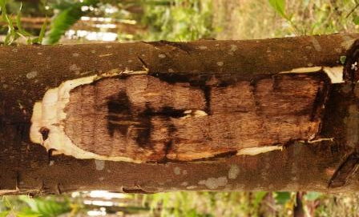
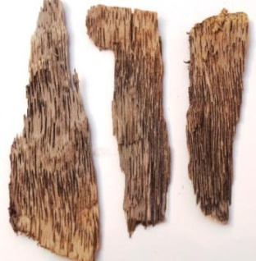
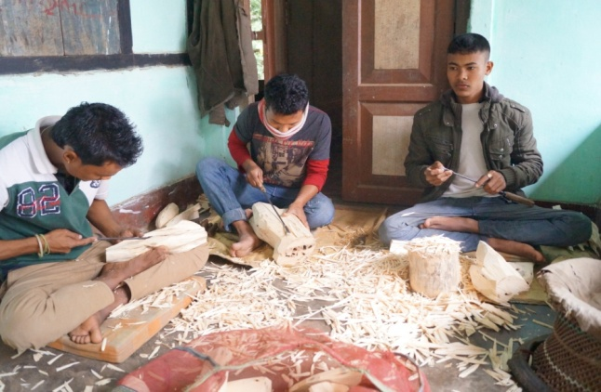
Agarwood Trade
Agarwood has become a precious commodity and is comparative to gold .
The international trade in agarwood involves wood, wood chips, powder, oil and products such as perfumes, incense and medicines.
The cost of agarwood is extremely high depending on the oleoresin content of the wood.
Prices range from a 10,000 to 30,000 US dollars per litre of agar oil.
Indonesia and Malaysia appear to be the main traders of agarwood in international trade and are the major contributors to import of agar in India.
Considering the economic importance and abundance of
Sasi trees in North East, the trade of agarwood has become
a fascinating industry not only in this area, but also in
the whole world market.
Rain Forest Research Institute, Jorhat, Assam
(Indian Council of Forestry Research and Education)

Slide 11
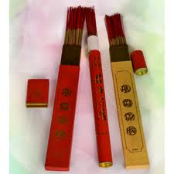
INDIA’S ROLE IN AGAR WOOD TRADE
India was previously the centre of a thriving industry and trade based on agar wood. Products produced and traded included wood, chips, powder and oil, being used mainly for perfumes, incense and medicine (including Ayurvedic).
Agar wood harvested from north-east Indian States, predominantly Assam, was taken to Hojai in Assam where it was processed into chips, dust and oil.
Importers and exporters previously supplied to traders in Mumbai and Calcutta, primarily with Assamese agar wood, but suppliers have largely shifted their base to south-east Asian countries, particularly Singapore, owing to the scarcity of Indian agar wood.
The A. malaccensis tree is becoming very rare in the wild due to illegal extraction. The extremely high prices paid for high quality agarwood and for the essential oil and the indiscriminate felling of diseased and healthy trees threaten natural stands of A. malaccensis to extinction.
The decline in the trade started 15-20 years ago. Even with the decline in trade, however, there is still an agar wood chip, oil and powder processing industry in India.
Rain Forest Research Institute, Jorhat, Assam
(Indian Council of Forestry Research and Education)

Slide 12
The Indian Forest Act 1927: Domestic harvests and both the intra and inter- State transport of agarwood.
In Assam, Lieu Transit Passes (LTPs) are issued by the Assam Forest Department to those who have legally transported agarwood from neighboring states (Manipur, Mizoram and Nagaland).
Export of agarwood has been prohibited since 1991 through EXIM policy: including log, timber, chip, powder, flake, dust, etc.
A. malaccensis is listed in the Appendix II of CITES since 1994.
EXIM policy (2009-2015) published by the Directorate General of Foreign Trade, Government of India, permits the export of plant portions of wild or cultivation origin of species specified under Appendix II or III of CITES but the export has to be supported with the production of certificate of legal possession in favour of the exporter, issued by the DFO having jurisdiction where the exporter is situated and also as per the provisions of CITES.
However, the Govt. of Assam has banned the export of agarwood parts and derivatives treating them as an essential commodity for the Small Scale Industry.
Imported agarwood may be re-exported as value added herbal formulations, if these are manufactured only from imported materials.
Rain Forest Research Institute, Jorhat, Assam
(Indian Council of Forestry Research and Education)

Slide 13
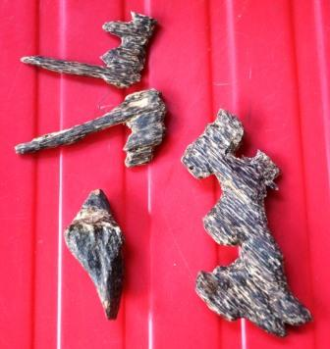
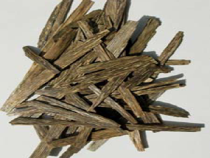
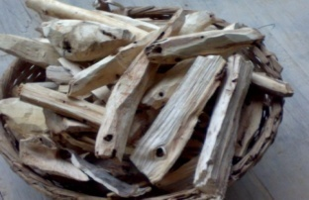
The rate varies from Rs. 500/- to Rs.12000/- per tola (11.66g) in North-East India.
As per the survey conducted by Assam Forest Department during 2003-2004, more than 90,00,000 agar plants of different age classes were enumerated in private land.
More than 9100 agar oil extraction units are working in Assam, requiring more than 7,28,000 trees of agar.
More than 1,50,000 workers and farmers are involved in the agar business and another 1.5 lakh benefit from it indirectly.
There is an urgent need to develop suitable regeneration strategies to augment its natural regeneration and conservation.
Rain Forest Research Institute, Jorhat, Assam
(Indian Council of Forestry Research and Education)

Slide 14
State wise description of status of agar wood in Northeast India
ASSAM
Illicit felling of agar wood was customary in Assam as early as 1905-1906.
The inhabitants of Dakhshinbagh, Sylhet (Now in Bangladesh), had the monopoly of the trade in agarwood and agar oil. After partition, agar experts crossed over to India and settled at Nilbagan, near Hojai (Nagaon district) the new location for trade operations.
The industry around Nilbagan is struggling to remain alive on a negligible collection of raw material from neighbouring states and Bhutan.
Only the worthwhile plantations in Sivsagar are still very young.
It has drastically reduced the growth of agar wood in the wild, bringing the legal production of agar oil almost to a halt.
Some wild trees are present in Nagaon, Sivsagar, Darrang and Cachar district (Chakrabarty et al.,1994).
Rain Forest Research Institute, Jorhat, Assam
(Indian Council of Forestry Research and Education)

Slide 15
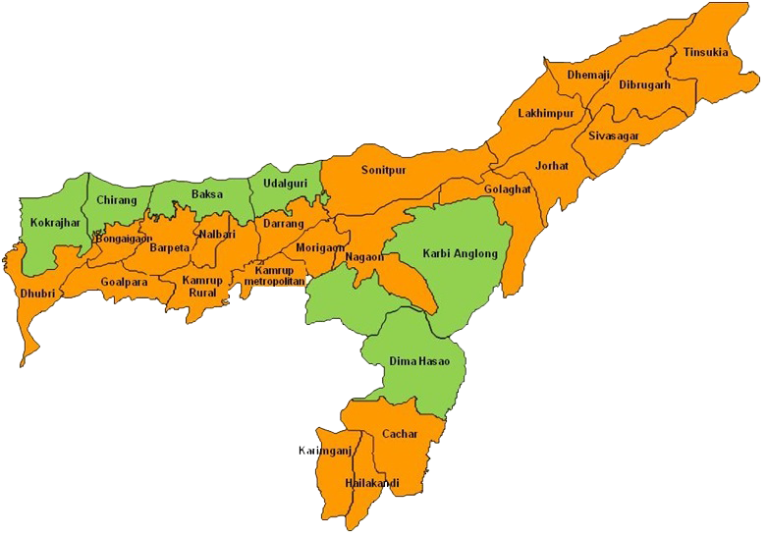
District wise distribution of Aquilaria malaccensis in Assam
A
A
A
A
A
A
A
A
A
A
A
A
A
A
A
A
Natural infection by Zeuzera conferta
A
A
Agar available
A
A

Slide 16
ARUNACHAL PRADESH
In Arunachal Pradesh, Aquilaria was abundant in earlier days but due to excessive extraction nowadays it is difficult to find it in the natural conditions.
The agar tree was reported in Pangsu reserve forests and Rima reserve forests in Tirap district of Arunachal Pradesh.
The forest department finally banned (1982-83) all commercial exploitation of agar wood in the state but this came after at least 26 years of regular extraction.
The regular exploitation of agar wood has depleted the once flourishing forest.
The silviculture division of Arunachal Pradesh has made elementary attempts to artificially regenerate the species on an experimental basis with the aim of augmenting wild stock.
Rain Forest Research Institute, Jorhat, Assam
(Indian Council of Forestry Research and Education)

Slide 17
Rain Forest Research Institute, Jorhat, Assam
(Indian Council of Forestry Research and Education)

Slide 18
MIZORAM
According to the local people, agar wood grew in abundance, until a few years ago, in the hillocks Maulkhang, Pukpui, Valam, Vanglawn, Hmarmul, Lunglei, Silphir which today present a ravaged landscape.
Nowadays, the tree grows sporadically near the tributaries of river Tuivawl, namely, Saichal lui, Ser lui, Ralzawn lui etc.
MEGHALAYA
Illicit felling and over exploitation of agar wood has endangered the species in the natural forest areas.
At present, only a few trees survive in the agar wood plantation of the Darugiri Reserve Forest.
Rain Forest Research Institute, Jorhat, Assam
(Indian Council of Forestry Research and Education)

Slide 19
NAGALAND
The dense forest of agarwood covering the Naga hills up to the elevation of 900m, have been reduced to a few sporadic trees, mainly in Dimapur range, Peren, Phek, Mon, Mokokchung, Tuensang and Wokha Forest Division.
Unskilled labour, hired to collect agar material, indiscriminately felled the trees and the tree is rare in the state today.
TRIPURA & MANIPUR
The wide distribution of agarwood up to an elevation of 1000m in the hills of Tripura and Manipur provided the agar oil industries with a ready storehouse of raw materials.
Irresponsible use of these precious natural resources has depleted stocks to an all time low.
Distilleries in Manipur are making a desperate bid to survive on meager raw material from neighboring states.
Rain Forest Research Institute, Jorhat, Assam
(Indian Council of Forestry Research and Education)

Slide 20
Legal status of agar wood in North East India
STATE | STATUS
ASSAM | Last extraction during the early eighties. Currently banned
ARUNACHAL PRADESH | Ban imposed during 1982-83. Currently banned
MEGHALAYA | No extraction from government forests has ever been allowed
MIZORAM | Extraction allowed/ lease year 1990-93 (possibly renewed)
NAGALAND | Extraction allowed/lease year 1991-92 (possibly renewed)
TRIPURA AND MANIPUR | No official ban. Limited collection.
Rain Forest Research Institute, Jorhat, Assam
(Indian Council of Forestry Research and Education)

Slide 21
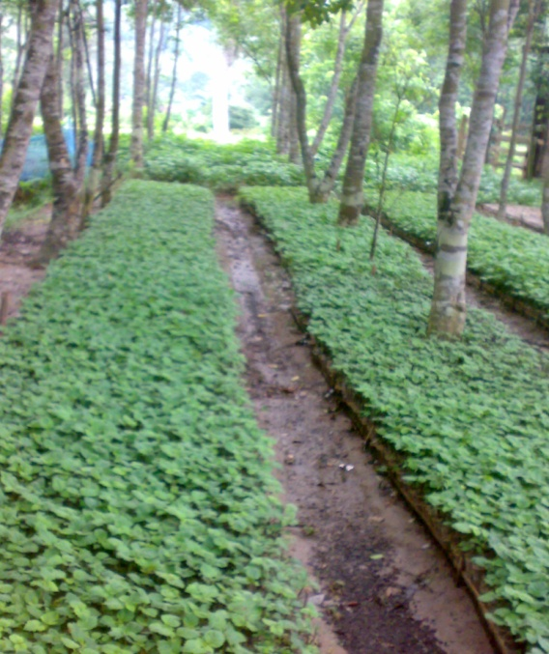
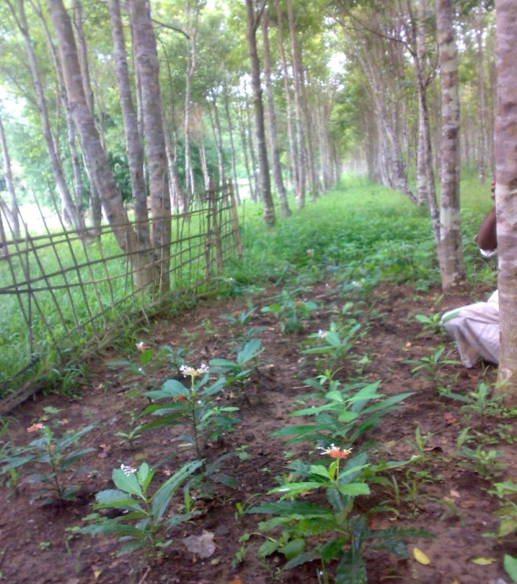
Agar tree in Mixed Plantations:
As a mixed crop, agar is planted at wider spacing according to the other companion crops depending upon the situations and purpose of planting.
Agar tree has been identified as a potential agroforestry species in homesteads, plantations and in community lands, in combination with patchouli (Pogostemon cablin), sarpagandha (Rouvolfia serpentina), Jatropha, pepper (Piper longum) and with other agricultural crops.
Rain Forest Research Institute, Jorhat, Assam
(Indian Council of Forestry Research and Education)

Slide 22
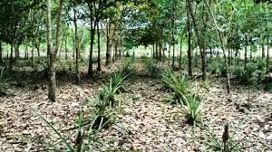
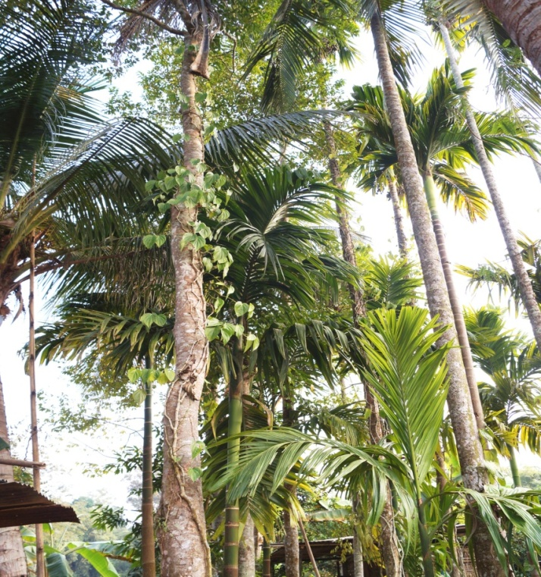
Besides, its plantation in the tea gardens of Assam can serve as an insurance against the natural calamities.
Turmeric, ginger, pineapple etc. may also be planted leaving about 50 cm around plant base.
Rain Forest Research Institute, Jorhat, Assam
(Indian Council of Forestry Research and Education)

Slide 23
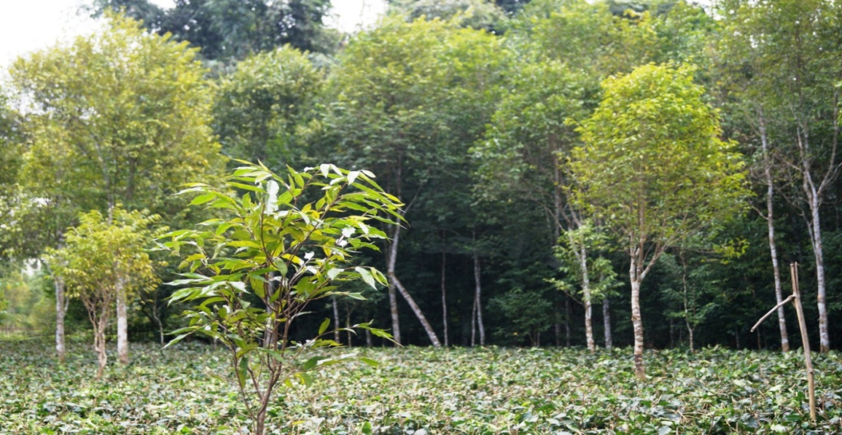
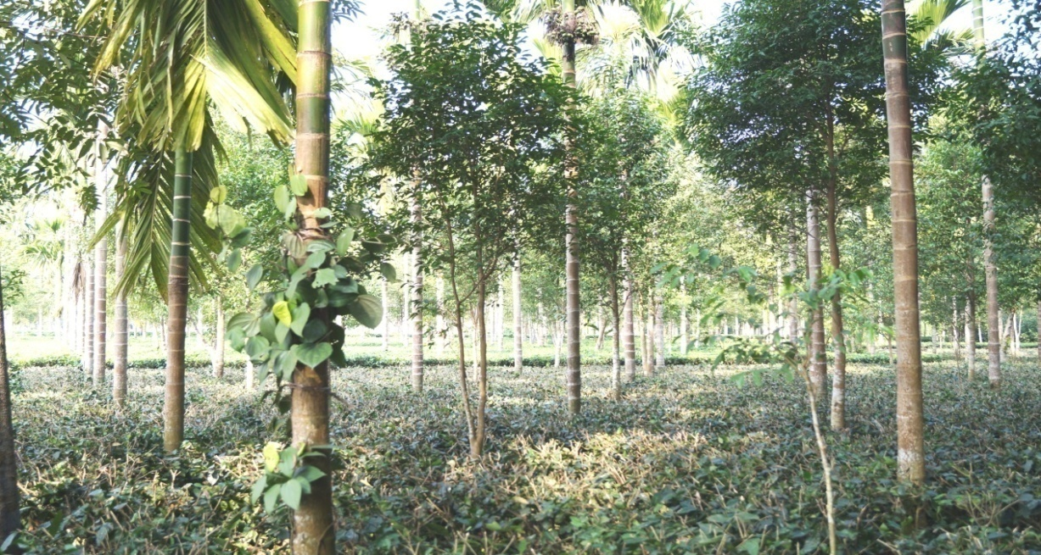
Agar with tea garden plantation
Agar with pepper, areca nut
and tea.
Rain Forest Research Institute, Jorhat, Assam
(Indian Council of Forestry Research and Education)

Slide 24
Wholesale prices for Aquilaria malaccensis fixed by
Assam Forest Department
Year | Grade | Price (Rs/kg)
1993 | 1st class Black Agar | 30,000
 | 2nd class Bantang | 20,000
 | 3rd class Phutas, Kalaguchi | 7500
 | 4th class Dhum | 100-250
1994 | 1st class Black Agar | 65,000
 | 2nd class Bantang | 15,000
 | 3rd class Phutas, Kalaguchi | 7,000
 | 4th class Dhum | 350
1998 | 1st class Black Agar | 50,000
 | 2nd class Bantang | 30,000
 | 3rd class Phutas, Kalaguchi | 10,000
 | 4th class Dhum | 450
2015 | 1st class Black Agar | 2,50,000 – 3,00,000
 | 2nd class Bantang | 25,000 – 30,000
Rain Forest Research Institute, Jorhat, Assam
(Indian Council of Forestry Research and Education)

Slide 25
Conservation and sustainable management of agarwood
Knowledge gaps about the biology and ecology of agarwood-producing species need to be filled and traditional, management practices should be integrated with the latest research findings.
To devise mechanism to allow benefits to return to local communities that have made available their knowledge of management practices for agarwood production.
Role of Botanical garden: function as “Noah’s Arks”, holding rare and endangered plants in productive custody until such time as they can be reintroduced into suitable wild habitat.
Rain Forest Research Institute, Jorhat, Assam
(Indian Council of Forestry Research and Education)

Slide 26
Management Of Wild Population
Inventory of wild population by the Working Plan Officers of respective forest departments of state governments.
Inclusions of proper prescriptions for conservation and regeneration of the species in the wild.
Coordinated Legal and policy issues for control over trade between all Agarwood producing states of the country.
Rain Forest Research Institute, Jorhat, Assam
(Indian Council of Forestry Research and Education)

Slide 27
Management Of Agarwood Plantations And NDF
Creation and proper inventory of plantations
There are estimated 9-10 million Aquilaria malaccensis trees in North East India on private lands.
Government owned cultivated trees are reportedly less.
The trend for cultivation is rising and great interest is generated in the south India also.
Research
Artificial inoculation
Identifying proper strains of causal fungi and inoculation
Techniques of inoculation( Injury, time of inoculation etc.)
Genetic evaluation of Aquilaria malaccensis in North Eastern India and establishment of Gene Bank
Rain Forest Research Institute, Jorhat, Assam
(Indian Council of Forestry Research and Education)

Slide 28
What can be achieved through research initiatives?
Series of cultivated species having wider and representative genetic base providing seed security for future plantations through out its range of occurrence under state control.
Motivating few if not all, private growers to establish preservation plots with R&D support from research institutes and advocating sustainable harvest.
Artificial inducements to avoid indiscriminate harvest of non-agar producing individuals.
Promoting research collaboration amongst all agar producing countries.
Rain Forest Research Institute, Jorhat, Assam
(Indian Council of Forestry Research and Education)

Slide 29
Artificial Treatment
for
Agarwood Formation
Rain Forest Research Institute, Jorhat, Assam
(Indian Council of Forestry Research and Education)

Slide 30
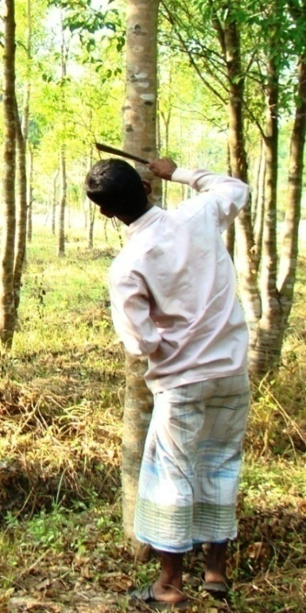
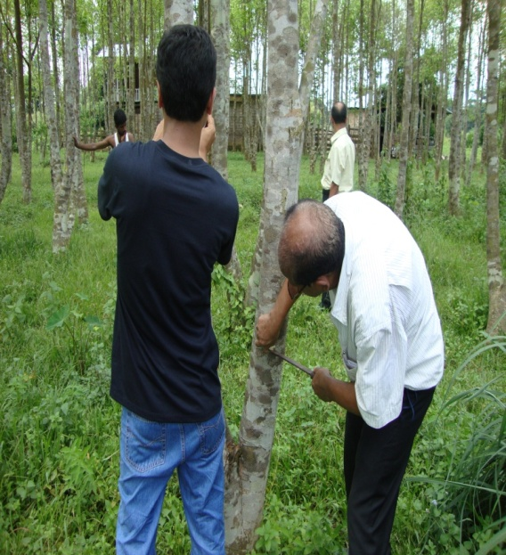
Open wounding with the help of Dao (Knife) on the tree trunk of agar tree can induce agarwood formation.
These injuries provides ready-made infection sites, and also put the tree to undergo a stress condition, which helps in spreading of infection.
Besides, artificial inoculation technique is found to be effective and reliable method for enhancement of agar formation.
In this technique, inoculation of dominant fungi species isolated from infected agar tree are carried out in non-infected tree, where agarwood formation starts after 3 months.
Rain Forest Research Institute, Jorhat, Assam
(Indian Council of Forestry Research and Education)

Slide 31
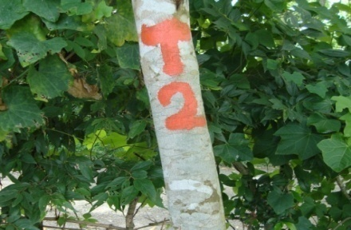
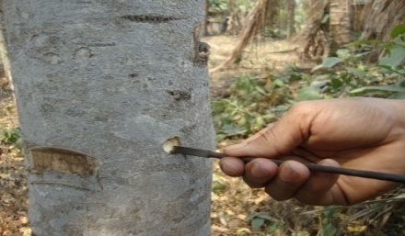
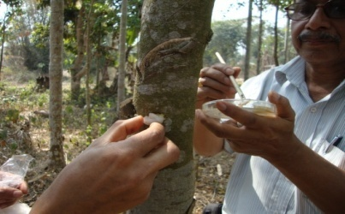
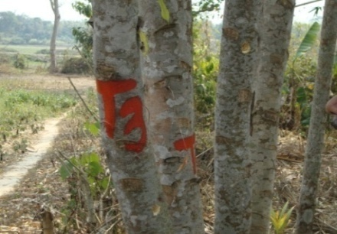
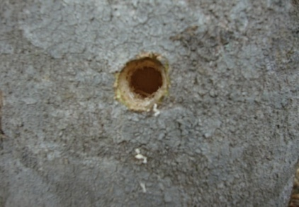
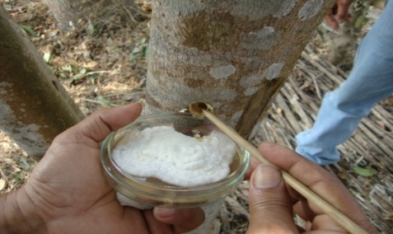
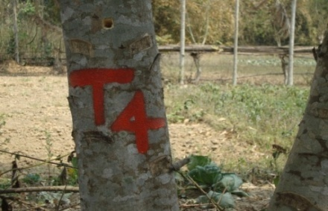
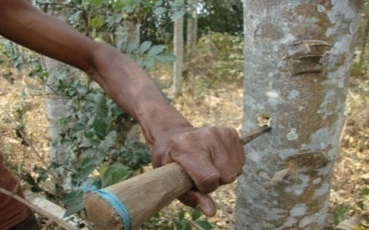
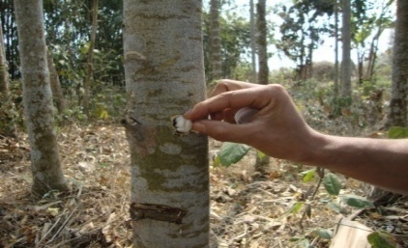
Artificial inoculation of fungi carried out in Tezpur, Assam for inducement of agarwood in agar trees in the month of March, 2011

Slide 32
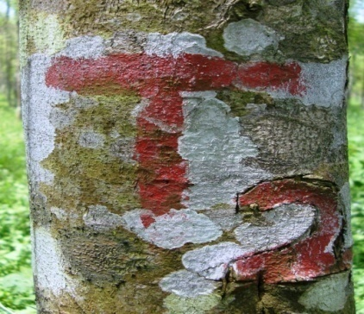
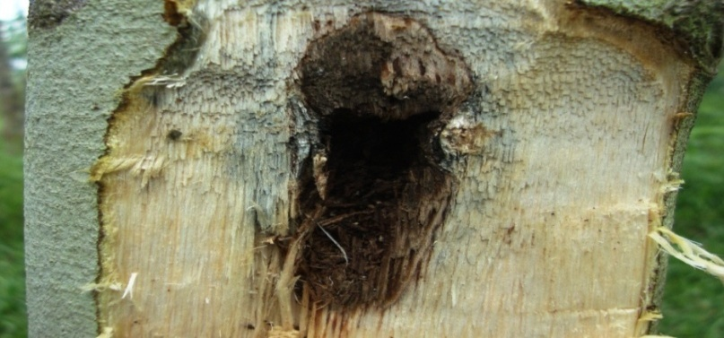
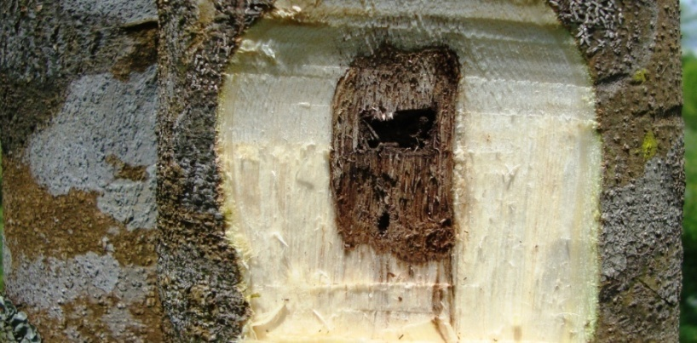
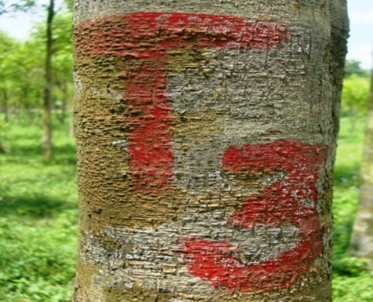
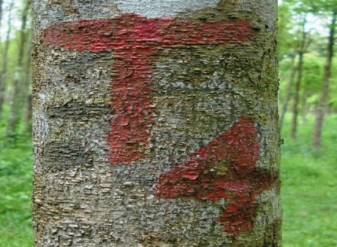
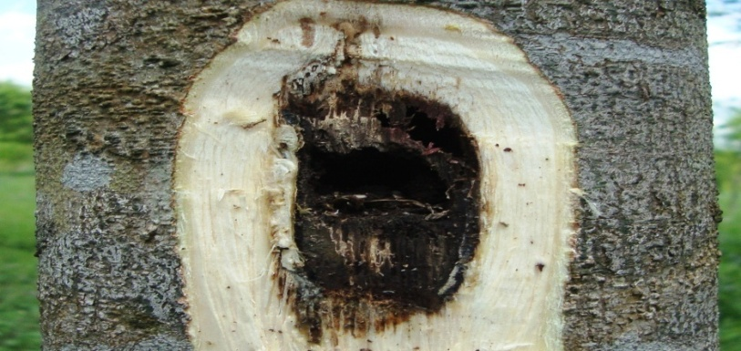
Visual observation for deposition of agarwood after 3 months in the month of June ,2011

Slide 33
Visual observation for formation of agar wood after inoculation (September,2011)
T1
T2
T3
T4
T5
Rain Forest Research Institute, Jorhat, Assam
(Indian Council of Forestry Research and Education)

Slide 34
Visual observation for formation of agar wood after inoculation (January,2012)
T2
T3
T4
T5
T6(Control)
Rain Forest Research Institute, Jorhat, Assam
(Indian Council of Forestry Research and Education)

Slide 35
Visual observation for formation of agarwood after 4 years of
artificial inoculation in Rowta (Udalguri district), Assam
T1
T2
T3
T4
T5
Rain Forest Research Institute, Jorhat, Assam
(Indian Council of Forestry Research and Education)

